Slide 1
Compiler Design
6- Attributed Grammars
Saeed Parsa
Room 332,
School of Computer Engineering,
Iran University of Science & Technology
parsa@iust.ac.ir
Winter 2021

Slide 2

Who, when/where, and what?
Who are we?
Lecturer
Saeed Parsa
Associate Professor in IUST
Research Area: Software Engineering, Software Testing, Software Debugging, Reverse Engineering, etc.
Email: parsa@iust.ac.ir
More Information:
http://parsa.iust.ac.ir/
Slide Share
https://www.slideshare.net/SaeedParsa

Slide 3
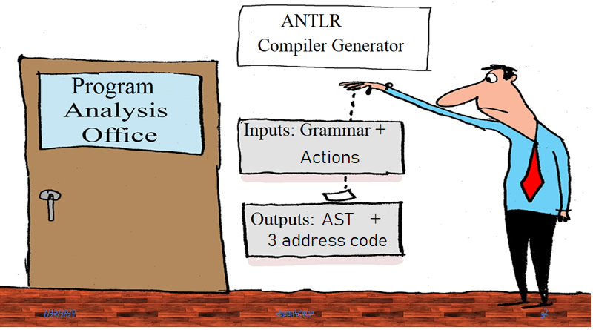

Slide 4

Attributed Grammars

Slide 5
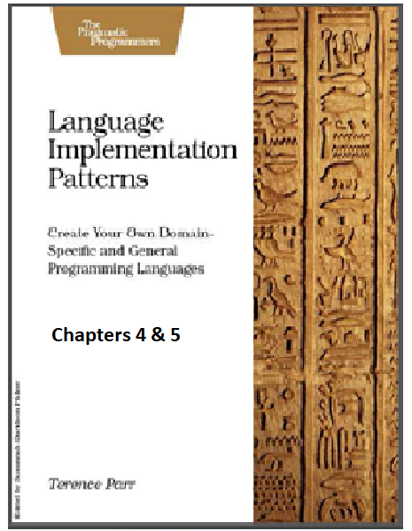
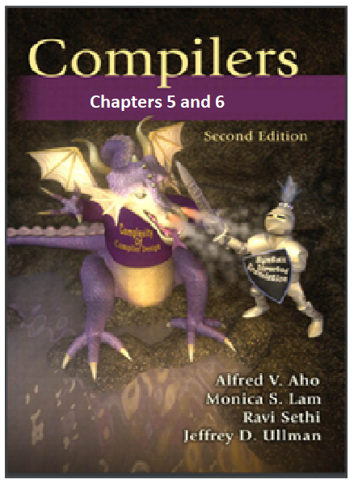
Who, when/where, and what?
Suggested References:
Compilers (chapters 5 and 6)
Language Implementation Patterns (chapters 4 and 5)

Slide 6
Who, when/where, and what?
Suggested References:
Compilers (chapters 5 and 6)
Language Implementation Patterns (chapters 4 and 5)
http://ce.sharif.edu/courses/94-95/1/ce414-2/resources/root/Text%20Books/Compiler%20Design/Alfred%20V.%20Aho,%20Monica%20S.%20Lam,%20Ravi%20Sethi,%20Jeffrey%20D.%20Ullman-Compilers%20-%20Principles,%20Techniques,%20and%20Tools-Pearson_Addison%20Wesley%20(2006).pdf
https://theswissbay.ch/pdf/Gentoomen%20Library/Programming/Pragmatic%20Programmers/Language%20Implementation%20Patterns.pdf

Slide 7

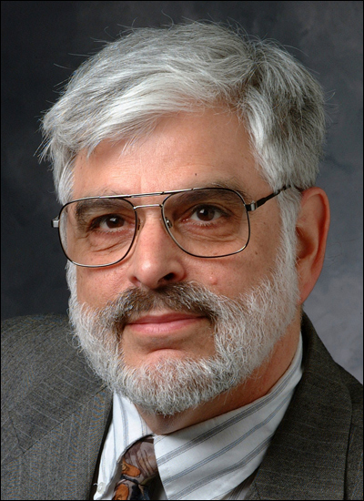
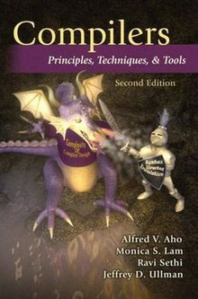
2020 ACM A.M. Turing Award Laureates
ACM Turing Award Honors Innovators Who Shaped the Foundations of Programming Language Compilers and Algorithms
Alfred Vaino Aho
Jeffrey David Ullman
Dragon book

Slide 8
What you will gain in this part
This part of the course deemed to be the most challenging.
When you finish this fight you are expected to posses all the skills to:
Develop tools to automatically detect smells and refactor source code.
Analyze source code to detect any possible vulnerability.
Develop tools for software testing.
Use different source code metrics to quantify quality.
Analyze source code for different purposes.
Develop your own reverse engineering tool.
Generate intermediate code.
Notes:
In the sense of this reasoning, actors become a source of change for the family of functions that serves them. As their needs change, that specific family of functions must also change to accommodate their needs

Slide 9
How: Syntax directed action
Write functions to take any desired action when visiting different symbols (terminal or non-terminal) while traversing the parse tree for a given source code.
A common method of syntax-directed action is translating a string into a sequence of actions by attaching one such action to each rule of a grammar.
The actions are implemented as methods dependent on whether for instance the aim is to refactor source code, detect smell, detect vulnerability or generate intermediate code.
Notes:
In the sense of this reasoning, actors become a source of change for the family of functions that serves them. As their needs change, that specific family of functions must also change to accommodate their needs

Slide 10

Intermediate code
Intermediate codes are machine independent codes, but they are close to machine
instructions.
Types of intermediate languages:
✓ Postfix notation can be used as an intermediate language
✓ Abstract syntax tree (AST_ can be used as an intermediate language.
✓ Three address code (Quadruples)
Page 375: http://index-of.es/Varios-2/Compilers.pdf

Slide 11
2.
Abstract syntax trees

Slide 12
Abstract Syntax Tree (AST)
Syntax Tree or Abstract Syntax Tree is a condensed form of parse tree.
Syntax trees are called as Abstract Syntax Trees because-
They are abstract representation of the parse trees.
They do not provide every characteristic information from the real syntax.
For example- no rule nodes, no parenthesis et
Why AST
Could be easily transformed into assembly cod
How
Remove brackets
Substitute parent nodes with only one child with their child.
Substitute parent nodes with the child that is an operator
Page 318: http://index-of.es/Varios-2/Compilers.pdf

Slide 13
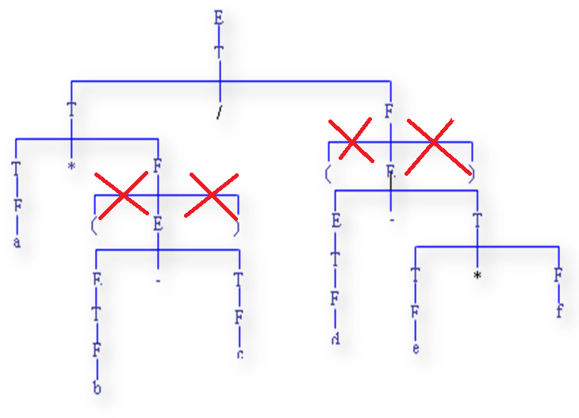
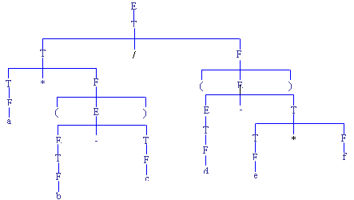
How to build an AST (Step -1)
Remove unnecessary parenthesis
E → E + T
E → E – T
E → T
T → T * F
T → T / F
T → F
F → (E)
F → id
F → no
unnecessary parenthesis removed
Input string
a * (b – c) / (d – e * f)

Slide 14
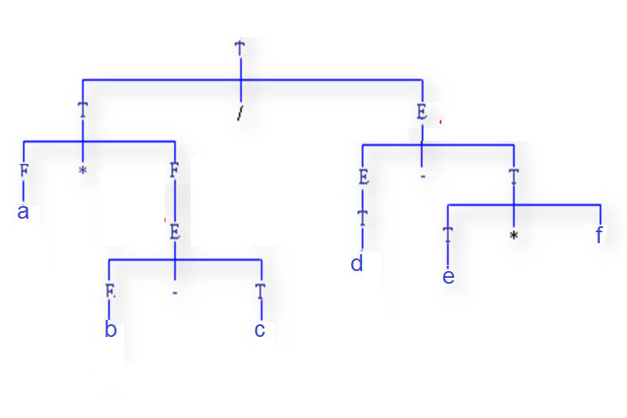
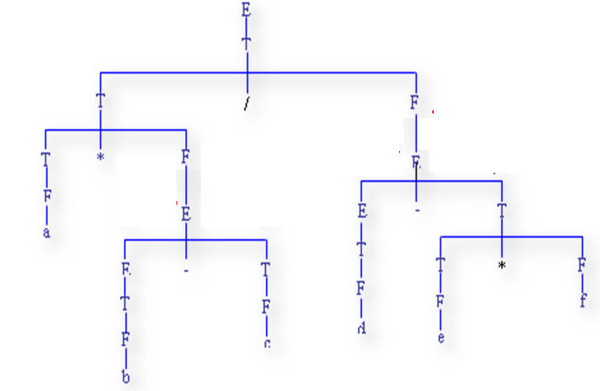
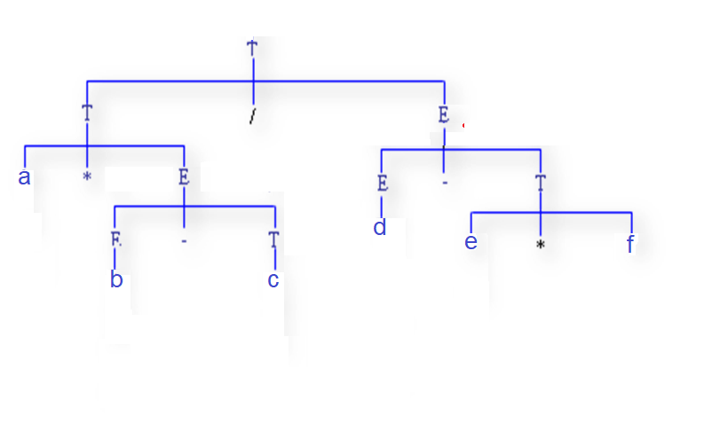
How to build an AST (Step -2)
E → E + T
E → E – T
E → T
T → T * F
T → T / F
T → F
F → (E)
F → id
F → no
Input string
a * (b – c) / (d – e * f)
II. Replace parents, having one child with their child

Slide 15
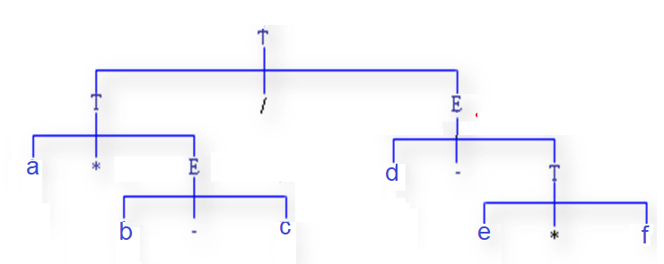
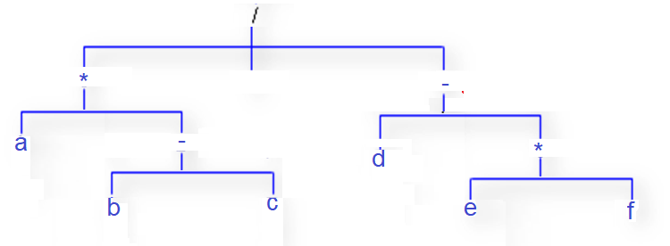
How to build an AST (Step -3)
E → E + T
E → E – T
E → T
T → T * F
T → T / F
T → F
F → (E)
F → id
F → no
Input string
a * (b – c) / (d – e * f)
III. Replace parents, with their child that is an operator

Slide 16

Why AST?
ASTs could b easily transformed into assembly code.
Traverse the tree in pre-order:
/ * a – b c – d * e f
Generate assembly code:
Mov ax, b
Sub ax, c
Mov bx, ax
Mov ax, a
Mul bx
Mov bx, ax
Mov ax, e
Mul f
Mov cx, ax
Mov ax, d
Sub ax, cx
Mov cx, ax
Mov ax, bx
Div cx

Slide 17
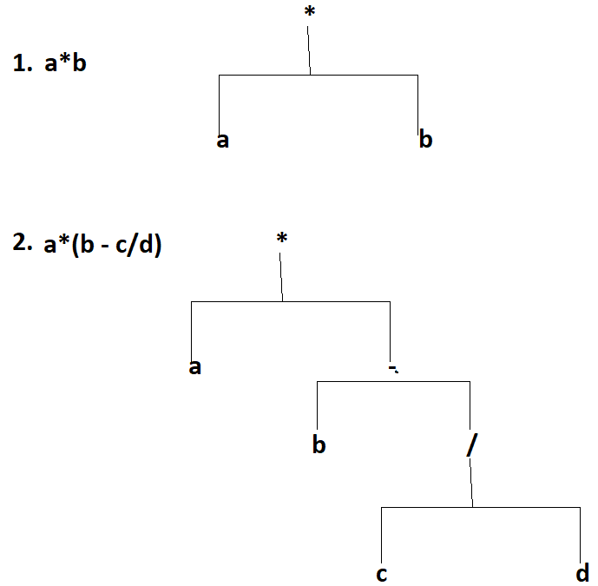
Tree representation of ASTs

Slide 18
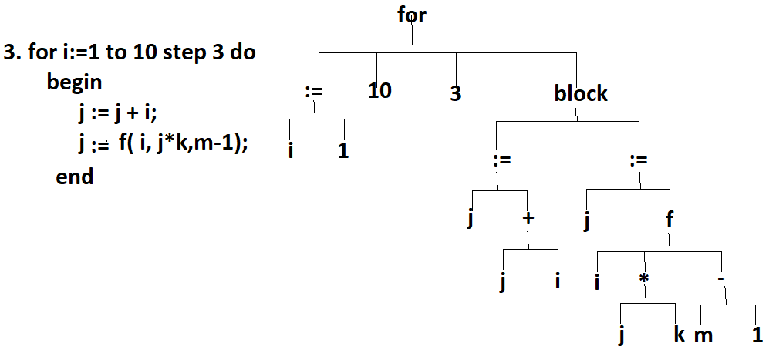
Tree representation of ASTs

Slide 19
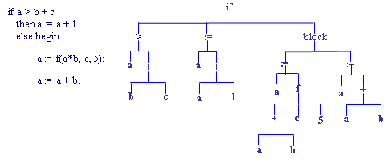
Tree representation of ASTs

Slide 20
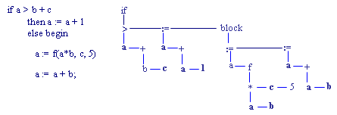
Binary Tree representation of ASTs

Slide 21
Binary tree representation of ASTs
First Brother
First Child
class treeNode :
def __init__(self, value, child, brother):
self.value = value
self.child = child
self.brother = brother
Typedef struct TreeNode
{
union value {enum symbols operator; char operand[10], }
struct TreeNode * child;
struct TreeNode * brother;
} TNode;

Slide 22
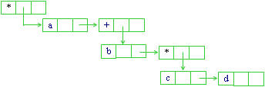
Binary tree representation of ASTs
a*(b + c*d)

Slide 23
Binary tree representation of ASTs
Case a*(b + c*d)
{
1: a = f(b+1, c-d);
breake;
5: if (i>j) i = i + b;
default a=a*b*c;
}

Slide 24
Syntax directed translation
Syntax-directed translation refers to a method of compiler implementation where the source language translation is completely driven by the parser.
Syntax-directed translation fundamentally works by adding actions to the productions in a context-free grammar, resulting in a Syntax-Directed Definition (SDD).
Actions are steps or procedures that will be carried out when that production is used in a derivation.
A grammar specification embedded with actions to be performed is called a syntax-directed translation scheme (sometimes simply called a 'translation scheme’.)

Slide 25
Syntax directed translation
Each symbol in the grammar can have an attribute, which is a value that is to be associated with the symbol.
Common attributes could include a variable type, the value of an expression, etc. Given a symbol X, with an attribute t, that attribute is referred to as X.t

Slide 26
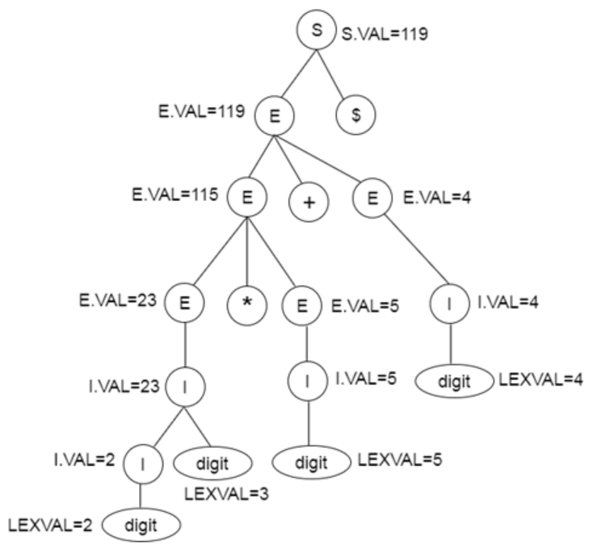
Parse tree for SDT
Production | Semantic Rules
S → E $ | { printE.VAL }
E → E + E | {E.VAL := E.VAL + E.VAL }
E → E * E | {E.VAL := E.VAL * E.VAL }
E → (E) | {E.VAL := E.VAL }
E → I | {E.VAL := I.VAL }
I → I digit | {I.VAL := 10 * I.VAL + LEXVAL }
I → digit | { I.VAL:= LEXVAL}

Slide 27
AST Class in CPP
class AST
{ private:
struct TreeNode *root;
public:
AST( ){ root = NULL; }
TreeNode * MakeNode(enum symbols op, struct TreeNode * ch, struct TreeNode * br)
{ struct TreeNode *node = new TreeNode;
node->value.operator = op; node->child = ch; node->brother = br;
if ( !root ) root = node;
return node; }
TreeNode * MakeNode(char *op, struct TreeNode *ch, struct TreeNode *br)
{ struct TreeNode *node = new TreeNode;
Strcopy(node->value.operand, op); node->child = ch; node->brother= br;
if ( !root ) root = node;
return node; }

Slide 28
AST Class in CPP
TreeNode * MakeLeaf(char *val)
{ struct TreeNode *node = new TreeNode;
Strcopy(node->value.operand,val); node->child = node->brother= NULL;
if ( !root ) root = node;
return node; }
void AddChild(struct TreeNode * father, struct TreeNode* child)
{ struct TreeNode *node;
node = father->child;
if(!node) {father->child = child; return;}
while( node->brother ) node := node->brother;
node->brother = child; }
void AddBrother(struct TreeNode * b, struct TreeNode* brother)
{ struct TreeNode *node;
node = b;
while( node->brother ) node := node->brother;
node->brother = brother; }
}; //End of AST

Slide 29
2.1 ANTLR Listener

Slide 30
ANTLR Listener
What?
Listener is a class that is automatically generated by ANTLR4.8 jar for a given grammar, G.g4, and has entry and exit methods for each of the grammar rules.
While the recursive descent parser, parses the tree, when it first invokes a non-terminal symbol, N, it invokes the method, enterN(), and when it returns to N, in a depth-first traversal of the parse tree, it invokes the exitN() method
Why ?
To take any desired action while walking through the parse tree.
How to use Listener ?

Slide 31
ANTLR Listener
Define two attributes, value_attr, type_attr, for each non-terminal definition in the grammar:
eg. e : e ‘+’ t | e ‘–’ t | t;
⇒ e [ returns value_attr, type_attr ] : e ‘+’ t | e ‘–’ t | t;
Use ANTLR4.8 to generate parser, lexer and listner classes, named Glistener.py, Gparser.py and Glistener.py for the grammar G.
Define your Listener, myGrammmarListener, as a subclass of the Listener, grammarNameListener, generated by ANTLR.
Eg. class myGrammarNameListener(grammarNameListener).

Slide 32
ANTLR Listener
Override the desired methods in your listener class.
eg. def exitE_t_plus(self, ctx: grammrParser.E_t_plusContext):
ctx.value_attr = ctx.e().value_attr + ‘+’ + ctx.t().value_attr;
eg. def exitF_id(self, ctx: grammrParser.F_idContext):
ctx.value_attr = ctx.ID().getText()

Slide 33
ANTLR Listener
Make a walker object:
walker = ParseTreeWalker()
walker.walk(t=parse_tree, listener=code_generator_listener)
Note:
When calling exit methods the very first method invoked is the leftmost leave of the tree.
In fact the exit methods are invoked from the bottom to the top.

Slide 34
1. Define the grammar
grammar AssignmentStatement2;
start returns [value_attr = str(), type_attr = str()]: prog EOF ;
prog returns [value_attr = str(), type_attr = str()]: prog assign | assign ;
assign returns [value_attr = str(), type_attr = str()]: ID ':=' expr (NEWLINE | EOF) ;
expr returns [value_attr = str(), type_attr = str()]:
expr '+' term #expr_term_plus
| expr '-' term #expr_term_minus
| expr RELOP term #expr_term_relop
| term #term4
;

Slide 35
1. Define the grammar
term returns [value_attr = str(), type_attr = str()]:
term '*' factor #term_fact_mutiply
| term '/' factor #term_fact_divide
| factor #factor3
;
factor returns [value_attr = str(), type_attr = str()]:
'(' expr ')’ #fact_expr
| ID #fact_id
| number #fact_number
;
number returns [value_attr = str(), type_attr = str()]:
FLOAT #number_float
| INT #number_int
;

Slide 36
1. Define the grammar
/* Lexical Rules */
INT : DIGIT+ ;
FLOAT:
DIGIT+ '.' DIGIT*
| '.' DIGIT+ ;
String:
'"' (ESC|.)*? '"' ;
ID:
LETTER(LETTER|DIGIT)* ;
fragment
DIGIT: [0-9] ;
fragment
LETTER: [a-zA-Z] ;
fragment
ESC: '\\"' | '\\\\' ;
WS: [ \t\r]+ -> skip ;
NEWLINE: '\n';
RELOP: '<=' | '<' ;

Slide 37
2. Define the AST Class (Python)
class AST:
def __init__(self):
self.root = None
self.current = None
def makeNode(self, value, child, brother):
tree_node = treeNode(value, child, brother)
if self.root is None:
self.root = tree_node
self.current = tree_node
return tree_node
def addChild(self, node, new_child):
if node.child is None:
node.child = new_child
else:
self.current = node.child
#self.current = node.child
while (self.current.brother) is not None:
self.current = self.current.brother
self.current.brother = new_child
self.current = new_child
def addBrother(self, node, new_brother):
if node.brother is None:
node.brother = new_brother
else:
self.current = node.brother
while (self.current.brother) is not None:
self.current = self.current.brother
self.current.brother = new_brother
self.current = new_brother

Slide 38
3. Use Listener to construct AST
from antlr4 import *
from code.assignment_statement_v2.gen.AssignmentStatement2Listener import AssignmentStatement2Listener
from code.assignment_statement_v2.gen.AssignmentStatement2Visitor import AssignmentStatement2Visitor
from code.assignment_statement_v2.gen.AssignmentStatement2Parser import AssignmentStatement2Parser
import queue
# Override the methods provided by the Listener
class ASTListener(AssignmentStatement2Listener):
def __init__(self):
self.ast = AST()
self.q = queue.Queue()

Slide 39
3. Override Listener to construct AST
def exitAssign(self, ctx: AssignmentStatement2Parser.AssignContext):
idPntr = self.ast.makeNode(value=ctx.ID().getText(), child=None, brother=ctx.expr().value_attr)
assPntr = self.ast.makeNode(value=":=", child=idPntr, brother=None)
ctx.value_attr = assPntr
self.ast.root = assPntr
self.print_tree(self.ast.root, 1)
def exitExpr_term_plus(self, ctx: AssignmentStatement2Parser.Expr_term_plusContext):
self.ast.addBrother(ctx.expr().value_attr, ctx.term().value_attr)
exprPntr = self.ast.makeNode(value="+", child=ctx.expr().value_attr, brother=None)
ctx.value_attr = exprPntr

Slide 40
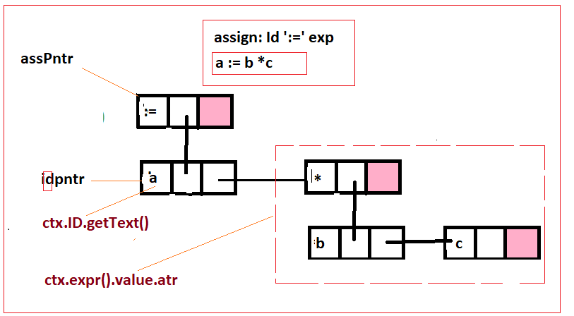
3. Example: exitAssign
def exitAssign(self, ctx: AssignmentStatement2Parser.AssignContext):

Slide 41
3. Override Listener to construct AST
def exitExpr_term_minus(self, ctx: AssignmentStatement2Parser.Expr_term_plusContext):
self.ast.addBrother(ctx.expr().value_attr, ctx.term().value_attr)
exprPntr = self.ast.makeNode(value="-", child=ctx.expr().value_attr, brother=None)
ctx.value_attr = exprPntr
def exitTerm4(self, ctx: AssignmentStatement2Parser.Term4Context):
ctx.value_attr = ctx.term().value_attr
def exitTerm_fact_mutiply(self, ctx: AssignmentStatement2Parser.Term_fact_mutiplyContext):
self.ast.addBrother(ctx.term().value_attr, ctx.factor().value_attr)
termPntr = self.ast.makeNode(value="*", child=ctx.term().value_attr, brother=None)
ctx.value_attr = termPntr

Slide 42
3. Override Listener to construct AST
def exitTerm_fact_divide(self, ctx: AssignmentStatement2Parser.Term_fact_divideContext):
self.ast.addBrother(ctx.term().value_attr, ctx.factor().value_attr)
termPntr = self.ast.makeNode(value="/", child=ctx.term().value_attr, brother=None)
ctx.value_attr = termPntr
def exitFactor3(self, ctx: AssignmentStatement2Parser.Factor3Context):
ctx.value_attr = ctx.factor().value_attr
def exitFact_expr(self, ctx: AssignmentStatement2Parser.Fact_exprContext):
ctx.value_attr = ctx.expr().value_attr
def exitFact_id(self, ctx: AssignmentStatement2Parser.Fact_idContext):
idPntr = self.ast.makeNode(value=ctx.ID().getText(), child=None, brother=None)
ctx.value_attr = idPntr

Slide 43
3. Override Listener to construct AST
def exitFact_number(self, ctx: AssignmentStatement2Parser.Fact_numberContext):
ctx.value_attr = ctx.number().value_attr
def exitNumber_float(self, ctx: AssignmentStatement2Parser.Number_floatContext):
numberPntr = self.ast.makeNode(value=ctx.FLOAT().getText(), child=None, brother=None)
ctx.value_attr = numberPntr
def exitNumber_int(self, ctx: AssignmentStatement2Parser.Number_intContext):
numberPntr = self.ast.makeNode(value=ctx.INT().getText(), child=None, brother=None)
ctx.value_attr = numberPntr
def print_tree(self, node=None, level=1):
if node is None:
print("--------Fenito----------")
return

Slide 44
3. Override Listener to construct AST
if not self.q.empty():
print('Parent:', self.q.get().value)
print('\t'*level, end='')
while node is not None:
print(node.value, '\t───\t', end='') # alt+196 = ───, alt+178=▓
if node.child is not None:
self.q.put(node.child)
self.q.put(node)
node = node.brother
if node is None:
print('▓', end='\n')
if not self.q.empty():
self.print_tree(node=self.q.get(), level=level + 1)

Slide 45
4. Write the program
from antlr4 import *
from code.assignment_statement_v2.gen.AssignmentStatement2Lexer import AssignmentStatement2Lexer
from code.assignment_statement_v2.gen.AssignmentStatement2Parser import AssignmentStatement2Parser
from code.assignment_statement_v2.Ast import ASTListener
import argparse
def main(args):
# Step 1: Load input source into stream
stream = FileStream(args.file, encoding='utf8')
print('Input code:\n{0}'.format(stream))
print('Result:')

Slide 46
4. Write the program
# Step 2: Create an instance of AssignmentStLexer
lexer = AssignmentStatement2Lexer(stream)
# Step 3: Convert the input source into a list of tokens
token_stream = CommonTokenStream(lexer)
# Step 4: Create an instance of the AssignmentStParser
parser = AssignmentStatement2Parser(token_stream)
# Step 5: Create parse tree
parse_tree = parser.start()
# Step 6: Create an instance of AssignmentStListener
code_generator_listener = ASTListener()
# Step 7(a): Walk parse tree with a customized listener (Automatically)
walker = ParseTreeWalker()
walker.walk(t=parse_tree, listener=code_generator_listener)

Slide 47
4. Write the program
# Step 7(b): Walk parse tree with a customize visitor (Manually)
# code_generator_vistor = ThreeAddressCodeGeneratorVisitor()
# code_generator_vistor = ThreeAddressCodeGenerator2Visitor()
# code_generator_vistor.visitStart(ctx=parse_tree.getRuleContext())
if __name__ == '__main__':
argparser = argparse.ArgumentParser()
argparser.add_argument(
'-n', '--file',
help='Input source', default=r'input.txt')
args = argparser.parse_args()
main(args)

Slide 48
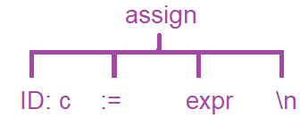



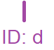


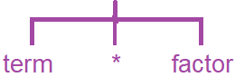


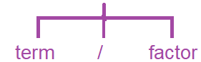
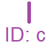


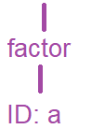
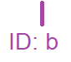


5. Example
Input string:
c := a / b * c + d

Slide 49
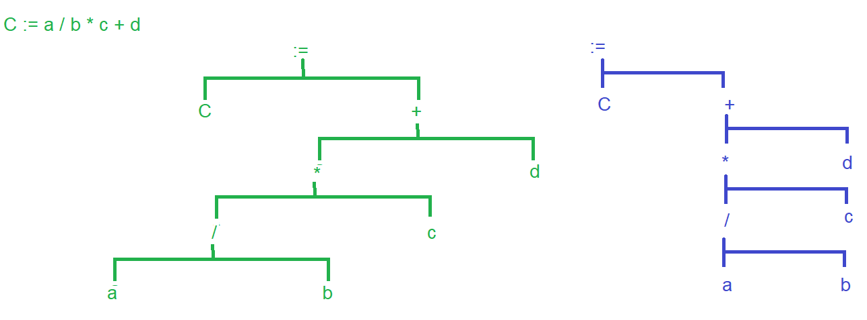
Example

Slide 50
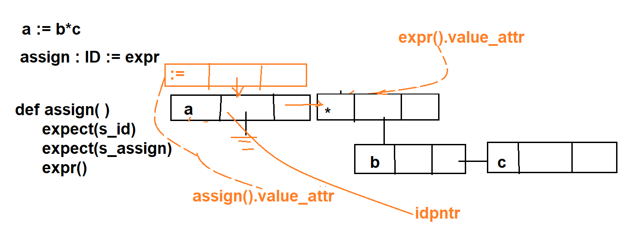
5. Example - 2
def exitAssign(self, ctx: AssignmentStatement2Parser.AssignContext):
idPntr = self.ast.makeNode(value=ctx.ID().getText(), child=None, brother=ctx.expr().value_attr)
assPntr = self.ast.makeNode(value=":=", child=idPntr, brother=None)
ctx.value_attr = assPntr
self.ast.root = assPntr
self.print_tree(self.ast.root, 1)

Slide 51
5. Example - 2
def exitAssign(self, ctx: AssignmentStatement2Parser.AssignContext):
idPntr = self.ast.makeNode(value=ctx.ID().getText(), child=None, brother=ctx.expr().value_attr)
assPntr = self.ast.makeNode(value=":=", child=idPntr, brother=None)
ctx.value_attr = assPntr
self.ast.root = assPntr
self.print_tree(self.ast.root, 1)
:=
Input string:
a := b * c
Grammar:
assign: ID := expr ;
a
*
def assign()
expect(S_id)
expect(s_assign)
expr()
b
c

Slide 52
5. Example - 2
def exitTerm_fact_mutiply(self, ctx: AssignmentStatement2Parser.Term_fact_mutiplyContext):
self.ast.addBrother(ctx.term().value_attr, ctx.factor().value_attr)
termPntr = self.ast.makeNode(value="*", child=ctx.term().value_attr, brother=None)
ctx.value_attr = termPntr
Input string:
a := b * c
Grammar:
term :
term ‘*’ factor
*
b
c
def term()
term()
expect(s_multiply)
factor() ;

Slide 53
6. Example - 3
1. Grammar
ifStmt returns [value_attr = str(), type_attr = str()]:'if' expr statment ('else' statment)?;

Slide 54
3. Three address code

Slide 55
Three address codes
Three-address codes are a form of intermediate representation similar to assembler for an imaginary machine.
Each three address code instruction has the form:
x := y op z
x,y,z are names (identifiers), constants, or temporaries (names generated by the compiler)
op is an operator, from a limited set defined by the IR.
Page 365:
http://ce.sharif.edu/courses/94-95/1/ce414-2/resources/root/Text%20Books/Compiler%20Design/Alfred%20V.%20Aho,%20Monica%20S.%20Lam,%20Ravi%20Sethi,%20Jeffrey%20D.%20Ullman-Compilers%20-%20Principles,%20Techniques,%20and%20Tools-Pearson_Addison%20Wesley%20(2006).pdf
Page 99, 365, Compiler writing – Aho

Slide 56
Three address codes
Three-address codes are a form of intermediate representation similar to assembler for an imaginary machine.
Each three address code instruction has the form:
x := y op z
x,y,z are names (identifiers), constants, or temporaries (names generated by the compiler)
op is an operator, from a limited set defined by the IR.
Three-address code is a sequence of statements of the general form
A := B op C,
where A, B, C are either programmer defined names, constants or compiler-generated temporary names;
op stands for an operation which is applied on A, B.

Slide 57

Three address codes
In simple words, a code having at most three addresses in a line is called three address code.
The three address code for the statement x := a + b * c is:
T1 := b*c;
T2 := a + T1;
x := T2;
Where T1, T2 and T3 are temporary variables generated by
the compiler.
:=
x
+
a
*
b
c
Abstract syntax tree(AST)

Slide 58
Types of three address code
 | Statement | Meaning
Assignment statements | X = Y op Z | Binary Operation
 | X= op Z | Unary Operation
 | X = Y | Assignment
 | A[i] = X Y= A[i] | Array Indexing
 | P = &X Y = *P *P = Z | Pointer Operations
Jumps | if X(rel op)Y goto L | Conditional Goto
 | goto L | Unconditional Goto
Call instruction | a = f(p1, …,pn) | Push p1; … Push pn, Call f,n; Pop a;

Slide 59
Example : 1
The three address code for the statement a:=b*-c+b*-c is:
t1 := -c
t2 := b * t1
t3 := -c
t4 := b * t3
t5 := t2 + t4
a := t5
We can reduce the number of temporaries as follows:
t1 := -c
t2 := b * t1
t1 := t2 + t2
a := t1
:=
a
+
*
*
b
-
b
-
c
c
Abstract syntax tree(AST)

Slide 60
Example : 2
The three address code for a := b * (c – d) * e / f is:
t1 := c – d
t1 := b * t1
t1 := t1 * e
t1 := t1 / f
a := t1
:=
a
/
*
f
*
e
assSt : ID ‘:=‘ e ;
e : e ‘+’ t | e ‘-’ t | t;
t : t ‘*’ f | t ‘/’ f | f;
F : ‘(‘ e ‘)’ | ID ;
ID : [a-zA-Z] ;
WS : [ \t\n\r] ;
b
-
c
d
Abstract syntax tree(AST)

Slide 61
Example : 3
The three address code for:
If a > b then a := a – 1 else a := a + 1
The three address code is:
if !(a > b) goto L1;
a := a -1;
goto L2;
L1. a := a + 1;
L2.
if
>
:=
:=
a
b
a
-
a
+
a
1
a
1
stmt : ifStmt | ID;
ifStmt : 'if’ cond stmt ('else' stmt)?;
cond : e ‘>’ e ;
ID : [a-zA-Z]+;
WS : ' '+ -> skip;
Abstract syntax tree(AST)

Slide 62
Example : 4
The three address code for:
If a > b then a := a – 1 else a := a + 1
The three address code is:
if !(a > b) goto L1;
a := a -1;
goto L2;
L1. a := a + 1;
L2.
if
>
:=
:=
a
b
a
-
a
+
a
1
a
1
stmt : ifStmt | ID;
ifStmt : 'if’ cond stmt ('else' stmt)?;
cond : e ‘>’ e ;
ID : [a-zA-Z]+;
WS : ' '+ -> skip;
Abstract syntax tree(AST)

Slide 63
Example : 5
The three address code for:
For I := 1 to a*b do a := a*I + a
The three address code is:
I := 1;
T1 := a*b;
L1: If I > T1 goto L2;
T2 := a*I
a := T2 + a;
I := I + 1;
goto L1;
L2:
for
:=
*
:=
I
1
a
b
a
+
*
a
a
I
stmt : ifStmt | forstmt | assst;
forstmt : ‘for’ ID ‘:=‘ e ‘to’ e ‘do’ stmt;
Abstract syntax tree(AST)

Slide 64
Examples : 6
for( i = a*b +1, j =2; i < j*n +2; i++)
a = a `+ 2;
1. Three address code:
T1 := a*b;
T1 := T1 +1;
i := T1;
j =2;
L1: T1 := j * n;
T1 := T1 + 2;
T1 := i< T1;
if( not T1 ) goto L4;
goto L3;
L2: i := i + 1;
goto L1;
L3: a := a + 2;
goto L2;
L4: ...
for
,
<
=
+
=
=
i
+
i
+
a
+
i
+
j
2
*
2
i
1
a
2
*
1
j
n
a
b
2. Abstract syntax tree (AST)

Slide 65
Example : 6
The three address code for:
If (a*c > b) {a ++; b = f(a+ b);}
The three address code is:
T1 := a*c;
if !(T1 > b) goto L1;
a := a +1;
T1 := a+b;
push T1;
call f, 1;
pop b
L1. …
if
>
block
null
*
b
:=
:=
a
c
a
+
b
f
stmt : ifStmt | assst | callst;
ifStmt : 'if’ cond stmt ('else' stmt)?;
cond : e ‘>’ e ;
Callst : ID ‘(‘ parsams? ‘)’ ;
params : e (, e)* ;
+
a
1
a
b
Abstract syntax tree(AST)

Slide 66
3.1
Syntax directed translation

Slide 67
Syntax directed translation
An interpreter executes a program statements while recognizing (parsing) the statements.
A compiler generates intermediate code (three-address-code/AST) while analyzing the syntax. This is called syntax directed translation.
’Syntax Directed Translation’ means driving the entire compilation (translation) process with the syntax recognizer (the parser).
In fact, the syntax analysis and intermediate-code generation are performed side by side in one path.
Page 303, chapter 5:
https://drive.google.com/file/d/0B1MogsyNAsj9elVzQWR5NWVTSVE/view

Slide 68
Syntax directed translation
Attributes are associated with grammar symbols and rules with productions
As an example, a holder, expr_attr, to hold the value and anther one, type_attr, to hold the type of each nonterminal is used.
Similar attributes are defined for the ‘term’ and ‘factor’ non-terminal symbols.
Attributes may be of many kinds: numbers, types, table references, strings, etc.
Synthesized attributes
A synthesized attribute at node N is defined only in terms of attribute values of children of N.
Inherited attributes
An inherited attribute at node N is defined only in terms of attribute values at N’s parent, N itself and N’s siblings.

Slide 69
3.2
Attributed grammar
For regular expressions

Slide 70
Attributes
Use the following functions to develop three address code.
A new fresh temporary can be created with the following function:
int create_temp()
{ return(strcat(“T”,int2str(++Temp_no)));}
Temp_no is a global integer, initially set to zero.
In the following attributed grammar Value_attr holds the three address code generated for its associated non-terminal symbol.

Slide 71
Syntax directed translation
expr ::= expr¹ ‘+’ term { if (expr¹_type != term_type ) type_error();
expr_type = expr¹_type;
expr_attr = create_temporary()
weite2_3addrcode_file(expr_attr + “=“ + expr¹_attr + ‘+’
term_attr;}
expr ::= term { if (expr¹_type != term_type ) type_error();
expr_type = term_type;
expr_attr = term_attr;
term ::= term¹ ‘*’ factor { if (term¹_type != factor_type ) type_error();
term_type = term¹_type;
term_attr = create_temporary()
weite2_3addrcode_file(term_attr + “=“ + term¹_attr + ‘*’
term_attr;}

Slide 72
Syntax directed translation
term ::= factor { term_type = factor_type;
term_attr = factor_attr; }
factor ::= ( expr ) { factor _type = expr_type;
factor_attr = term_attr;
factor ::= ID { factor _type = ‘string’; // to be looked up in symbol table;
factor_attr = ID.lexeme; }
factor ::= FLOAT { factor _type = ‘Float’; // to be inserted into the symbol table;
factor_attr = FLOAT.lexeme; }
factor ::= INT { factor _type = ‘Int’; // to be inserted into the symbol table;
factor_attr = INT.lexeme; }

Slide 73
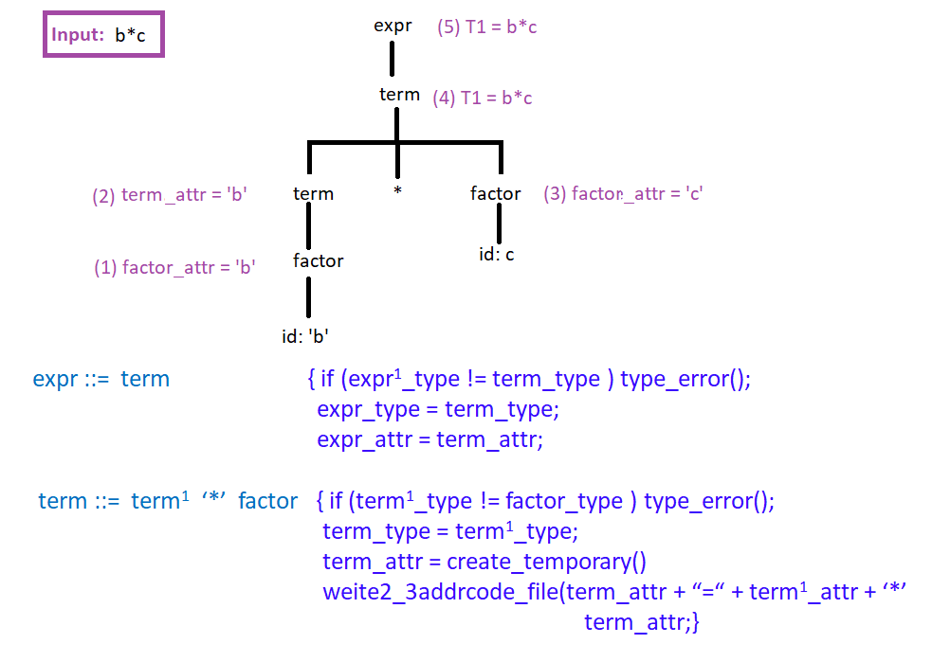
Syntax directed translation

Slide 74
Pascal functions used for three addr. Code generation
// Define temporary variables number as a global integer.
var //Declar two global variables
TempNo, LabelNo: integer;
procedure Init;
begin //Initialize global variables, TempNo and LabelNo to zero
TempNo := 0;
LabelNo := 0;
// A new (fresh) temporary can be created with a create_temp()
// funtion.
function NewTemp: string;
begin //Creates a new temporary variable
TempNo := TempNo + 1;
NewTemp := ‘T’ + int2str(TempNo);
end;

Slide 75
3.3
Functions for writing actions

Slide 76
1. Pascal functions and procedures
// Removes the latest created global variable number.
procedure RemoveTemp;
begin // Removes the last temporary number
TempNo := TempNo - 1
end;
// A new (fresh) label can be created with a create_temp() function.
function NewLabel: string;
begin //crates a new label
LabelNo := LabelNo + 1
NewLabel := ‘L’ + int2str(LabelNo);
end;

Slide 77
Optimized three address code generation : 3
// Checks whether a given variable, var, is a temporary variable
function isTemp(T: string): boolean;
begin // Returns true if T is a temporary variable
…
end;
// Writes the generated three address code into the target file
procedure Emitlne(s: string);
begin //writes the parameter S into a file
writeln(target, s);
end;

Slide 78
2. Python functions
The following Python class can be used To develop a three address code generators.
We use an attribute holder generator called create_temp().
A new fresh label can be created with a create_label()function.
// Define temporary variables number as a global integer.
@parser::members{
temp_counter = Label_counter = 0
// A new (fresh) temporary can be created with a create_temp()
// funtion.
def create_temp(self):
self.temp_counter += 1
return 'T' + str(self.temp_counter)

Slide 79
Optimized three address code generation : 3
// A new (fresh) label can be created with a create_temp() function.
def create_label(self):
self.label_counter += 1
return ‘L' + str(self.temp_counter)
// Checks whether a given variable, var, is a temporary variable
def is_temp(self, var:str):
if var[0] == 'T':
return True
return False
// Removes the latest created global variable number.
def remove_temp(self):
self.temp_counter -= 1
}

Slide 80
3.4
Actions

Slide 81
Adding Actions to the grammar
// expr ::= expr ‘+’ term
expr returns [value_attr = str(), type_attr = str()]
: e=expr ‘+' t=term { //1- Type checking
if $e.type_attr != $t.type_attr:
print(‘Type mismatch: “-" operator: Inconsistent types!’)
else:
// 2- set attributes
temp = self.create_temp()
$value_attr = temp
print(temp, '=', $e.value_attr, ‘+', $t.value_attr)}
// expr ::= term
expr returns [value_attr = str(), type_attr = str()]
: t=term { $type_attr = $t.type_attr;
$value_attr = $t.value_attr; } ;

Slide 82
Attributed grammar for expressions: 1
// term ::= term ‘*’ factor
term returns [value_attr = str(), type_attr = str()]
: t=term ‘*’ f=fatcor { //1- Type checking
if $t.type_attr != $f.type_attr:
print(‘Type mismatch: “-" operator: Inconsistent types!’)
else:
// 2- set attributes
temp = self.create_temp()
$value_attr = temp
print(temp, '=‘, $t.value_attr, ‘/’, $f.value_attr)}
// term ::= factor
term returns [value_attr = str(), type_attr = str()]
: f=factor { $type_attr = $f.type_attr;
$value_attr = $f.value_attr; } ;

Slide 83
Attributed grammar for expressions
// factor ::= (expr) | ID | Number
factor returns [value_attr = str(), type_attr = str()]:
: '(' e=expr ')' {$type_attr = $e.type_attr
$value_attr = $e.value_attr }
| ID {$type_attr = 'str’
$value_attr = $ID.text }
| n=number {$type_attr = $n.type_attr
$value_attr = $n.value_attr } ;

Slide 84
Attributed grammar for expressions
// number ::= INT | Foat
number returns [value_attr = str(), type_attr = str()]
: INT {$value_attr = $INT.text
$type_attr = 'int’ }
|FLOAT {$value_attr = $FLOAT.text
$type_attr = 'float'}
;
// Note: All syntax rules start with a lower case letter
https://github.com/m-zakeri/IUSTCompiler

Slide 85
3.5
Python program for generating
three address code

Slide 86
Implementation steps
Step 1: Create a new Python project
Step 2: Define grammar rules
Define supplementary methods
Define grammar rules including the actions
Step 3: Generate parser
Right click on the grammar.g4
Select “generate ANTLE recognizer”
Step 4: Write the main function
Step 5: Run the program

Slide 87
Step 2: Attributed grammar for a calculator
grammar assignment_statement_v3;
// 1- define global variables and supplementary methods
@parser::members{
temp_counter = 0
//Generates temporary no, T1, T2, …
def create_temp(self):
self.temp_counter += 1
return 'T' + str(self.temp_counter)
// Remove temporary variables
def remove_temp(self):
self.temp_counter -= 1
// Is the variable, Var, a temporary
def is_temp(self, Var):
return 'T' + str(self.temp_counter)
}

Slide 88
Step 2: Attributed grammar for a calculator -2
// each non-terminal has two attributes, value _ate and type_attr keeping its value and type.
start returns [value_attr = str(), type_attr = str()]: p=prog EOF {$value_attr=$p.value_attr
$type_attr = $p.type_attr
print('Final Value:', $value_attr)
print('Final type:', $type_attr)
};
//Each program consists of several assignment statements, assign.
prog returns [value_attr = str(), type_attr = str()]: prog a=assign | a=assign {$value_attr=$a.value_attr
$type_attr = $a.type_attr
};
//Each non-terminal function return its two attributes, value_attr, and type_attr.
assign returns [value_attr = str(), type_attr = str()]: ID ':=' e=expr (NEWLINE | EOF) {$value_attr=$e.value_attr
$type_attr = $e.type_attr };
start ::= prog EOF
prog ::= prog assign | assign;
assign ::= id ‘:=‘ expr (NEWLINE|EOF) ;

Slide 89
Step 2: Attributed grammar for a calculator -3
expr ::= expr ‘+’ term
| expr ‘-’ term
| term;
// expr ::= expr ‘+’ term
expr returns [value_attr = str(), type_attr = str()]:
e=expr '+' t=term
{ //1- Type checking: when you add two operands their type should be compatible.
if $e.type_attr != $t.type_attr:
print('Semantic error4 in "+" operator: Inconsistent types!’)
else: // 2- set the type attribute, type_attr, and the value attribute, value_attr.
$type_attr = $t.type_attr
if $t.type_attr=='float’: //2.1 We should not compute the value, however we do.
$value_attr = str(float($e.value_attr) + float($t.value_attr))
elif $t.type_attr=='int’: //2.2 We should not compute the value, however we do.
$value_attr = str(int($e.value_attr) + int($t.value_attr))
elif $t.type_attr=='str’: // 2.3 This is the right work to do
temp = self.create_temp() // 2.3.1 Create a temporary variable
print(temp, '=', $e.value_attr, '+', $t.value_attr) // 2.3.2 save the string in the temp. var.
$value_attr = temp }

Slide 90
Step 2: Attributed grammar for a calculator -4
// expr ::= expr ‘-’ term
expr returns [value_attr = str(), type_attr = str()]:
e=expr ‘-' t=term
{ //1- Type checking: when you subtract two operands their type should be compatible.
if $e.type_attr != $t.type_attr:
print('Semantic error4 in “-" operator: Inconsistent types!’)
else: // 2- set the type attribute, type_attr, and the value attribute, value_attr.
$type_attr = $t.type_attr
if $t.type_attr=='float’: //2.1 We should not compute the value, however we do.
$value_attr = str(float($e.value_attr) - float($t.value_attr))
elif $t.type_attr=='int’: //2.2 We should not compute the value, however we do.
$value_attr = str(int($e.value_attr) - int($t.value_attr))
elif $t.type_attr=='str’: // 2.3 This is the right work to do
temp = self.create_temp() // 2.3.1 Create a temporary variable
print(temp, '=', $e.value_attr, ‘-', $t.value_attr) // 2.3.2 save the string in the temp. var.
$value_attr = temp }
expr ::= expr ‘+’ term
| expr ‘-’ term
| term;

Slide 91
Step 2: Attributed grammar for a calculator - 5
| t=term {$type_attr = $t.type_attr
$value_attr = $t.value_attr };
expr ::= expr ‘+’ term
| expr ‘-’ term
| term;

Slide 92
Step 2: Attributed grammar for a calculator -6
term ::= term ‘*’ factor
| term ‘/’ factor
| factor;
// term ::= term ‘*’ factor
term returns [value_attr = str(), type_attr = str()]:
t=term ‘*’ f=factor
{ //1- Type checking: when you multiply two operands their type should be compatible.
if $t.type_attr != $f.type_attr:
print('Semantic error4 in “*" operator: Inconsistent types!’)
else: // 2- set the type attribute, type_attr, and the value attribute, value_attr.
$type_attr = $f.type_attr
if $f.type_attr=='float’: //2.1 We should not compute the value, however we do.
$value_attr = str(float($t.value_attr) * float($f.value_attr))
elif $f.type_attr=='int’: //2.2 We should not compute the value, however we do.
$value_attr = str(int($t.value_attr) * int($f.value_attr))
elif $f.type_attr=='str’: // 2.3 This is the right work to do
temp = self.create_temp() // 2.3.1 Create a temporary variable
print(temp, '=‘, $t.value_attr, ‘*’, $f.value_attr) // 2.3.2 save the string in the temp. var.
$value_attr = temp }

Slide 93
Step 2: Attributed grammar for a calculator -7
// term ::= term ‘/’ factor
term returns [value_attr = str(), type_attr = str()]:
t=term ‘*’ f=factor
{ //1- Type checking: when you multiply two operands their type should be compatible.
if $t.type_attr != $f.type_attr:
print('Semantic error4 in / operator: Inconsistent types!’)
else: // 2- set the type attribute, type_attr, and the value attribute, value_attr.
$type_attr = $f.type_attr
if $f.type_attr=='float’: //2.1 We should not compute the value, however we do.
$value_attr = str(float($t.value_attr) / float($f.value_attr))
elif $f.type_attr=='int’: //2.2 We should not compute the value, however we do.
$value_attr = str(int($t.value_attr) / int($f.value_attr))
elif $f.type_attr=='str’: // 2.3 This is the right work to do
temp = self.create_temp() // 2.3.1 Create a temporary variable
print(temp, '=‘, $t.value_attr, ‘/’, $f.value_attr) // 2.3.2 save the string in the temp. var.
$value_attr = temp }
term ::= term ‘*’ factor
| term ‘/’ factor
| factor;

Slide 94
Step 2: Attributed grammar for a calculator -8
// term ::= factor
| f=factor {$type_attr = $f.type_attr
$value_attr = $f.value_attr };
term ::= term ‘*’ factor
| term ‘/’ factor
| factor;

Slide 95
Step 2: Attributed grammar for a calculator -9
factor ::= (expr)
| ID
| number;
// factor ::= (expr) | ID | Number
factor returns [value_attr = str(), type_attr = str()]:
'(' e=expr ')' {$type_attr = $e.type_attr
$value_attr = $e.value_attr }
| ID {$type_attr = 'str’
$value_attr = $ID.text }
| n=number {$type_attr = $n.type_attr
$value_attr = $n.value_attr } ;

Slide 96
Step 2: Attributed grammar for a calculator -10
factor ::= (expr)
| ID
| number;
// number ::= INT | Foat
number returns [value_attr = str(), type_attr = str()]
: INT {$value_attr = $INT.text
$type_attr = 'int’ }
|FLOAT {$value_attr = $FLOAT.text
$type_attr = 'float'}
;
// Notice: All syntax rules start with a lower case letter

Slide 97

Step 2: Attributed grammar for a calculator - 11
// 2- Lexical Rules
INT: DIGIT+ ;
FLOAT: DIGIT+ '.' DIGIT* | '.' DIGIT+ ;
ID: LETTER(LETTER|DIGIT)* ;
fragment
DIGIT: [0-9] ;
fragment
LETTER: [a-zA-Z] ;
WS: [ \t\r]+ -> skip ;
NEWLINE: '\n';

Slide 98

Step 3. Generate parser
Right click on the grammar file, assignments_st_v3.g4:
Right Click on yourGrammar.g4 ⇒ Configure ANTLR ⇒
Language ⇒ enter Python3
Output directory ⇒ …\gen
Right Click on yourGrammar.g4 ⇒ Generate ANTLR recognizer (CTRL Shift G)
A directory, gen, including the following files will be generated:
gen
__init__.py
assignment_statement_v3.interp
assignment_statement_v3.tokens
assignment_statement_v3Lexer.interp
assignment_statement_v3Lexer.py
Adjust indentation in assignment_statement_v3Parser.py
assignment_statement_v3Lexer.tokens
assignment_statement_v3Listener.py
assignment_statement_v3Parser.py
assignment_statement_v3Visitor.py

Slide 99

Step 4: Main script for the calculator
from antlr4 import *
from gen.assignment_statement_v3Lexer import assignment_statement_v3Lexer
from gen.assignment_statement_v3Parser import assignment_statement_v3Parser
from gen.assignment_statement_v3Listener import assignment_statement_v3Listener
import argparse
class MyListener(assignment_statement_v3Listener):
def exitFactor(self, ctx: assignment_statement_v3Parser.FactorContext):
pass

Slide 100
Step 4: Main script for the calculator
def main():
# Step 1: Load input source into stream
#stream = FileStream(args.file, encoding='utf8')
stream = InputStream(StdinStream()
# Step 2: Create an instance of AssignmentStLexer
lexer = assignment_statement_v3Lexer(stream)
# Step 3: Convert the input source into a list of tokens
token_stream = CommonTokenStream(lexer)
# Step 4: Create an instance of the AssignmentStParser
parser = assignment_statement_v3Parser(token_stream)
# Step 5: Create parse tree
parse_tree = parser.start()
# Step 6: Create an instance of AssignmentStListener
my_listener = MyListener()
walker = ParseTreeWalker()
walker.walk(t=parse_tree, listener=my_listener)
main()

Slide 101

Step 5: Run the program
Input stream:
x := (b + d / c) * a / (b-d)
y := a + b * c
z := a+b*c*(d - e/f)
Compiler result:
T1 = d / c
T2 = b + T1
T3 = T2 * a
T4 = b - d
T5 = T3 / T4
Assignment value: x = T5
Assignment type: str
// y := a + b * c
T6 = b * c
T7 = a + T6
Assignment value: y = T7
Assignment type: str
So many temporaries
//z := a+b*c*(d - e/f)
T8 = b * c
T9 = e / f
T10 = d - T9
T11 = T8 * T10
T12 = a + T11
Assignment value: z = T12
Assignment type: str

Slide 102
3.6
Minimize the number
of temporaries

Slide 103
Minimize temporaries
The three-address statement method represents a linearized version of the DAG or syntax tree in which explicit names correspond to the interior nodes of the tree.
A goal in any optimizing compiler is to minimize the creation of temporary variables.
As an example for the statement:
x := (b + d / c) * a / (b-d)
Five temporaries, T1 to T5, were created.
We reduce the number of temporaries from five to two.

Slide 104
Minimize temporaries
x := (b + d / c) * a / (b-d)
Unoptimized:
T1 = d / c
T2 = b + T1
T3 = T2 * a
T4 = b - d
T5 = T3 / T4
X := T5
Optimized:
T1 = d / c
T1 = b + T1
T1 = T1 * a
T2 = b - d
T1 = T1 / T2
X := T1

Slide 105
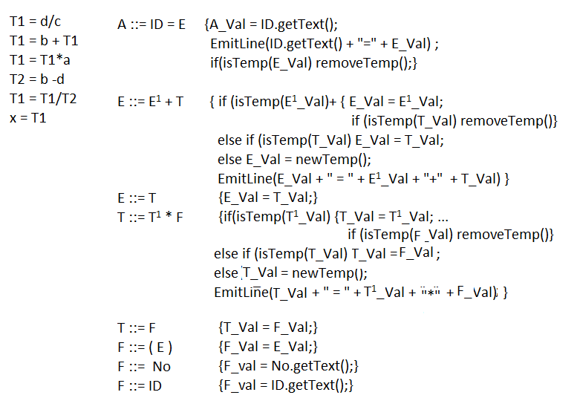
Minimize temporaries

Slide 106
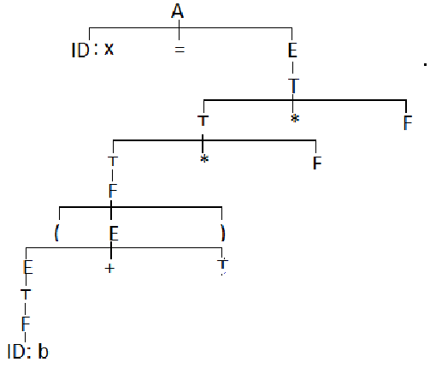
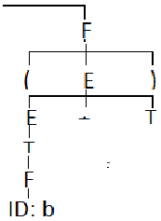
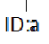
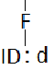
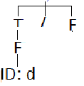
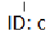
Execution results
A_Val = “x”
T1 = d / c
E_Val = “T1”
T1 = b + T1
T_Val = “T1”
T1 = T1*a
T_Val = “T1”
F_Val = “T2”
T2 = b - d
F_Val = “a”
T1 = T1*T2
T_Val=F_Val=“T1”
E_Val = “T2”
x = T1
F_Val = “T1”
E_Val = “T1”
E_Val = T_Val =“b”
T_Val = “T1”
T_Val =“d”
T_Val = F_Val =“b”
F_Val = “d”
F_Val = “c”
F_Val = “b”
E_Val = T_Val =“b”
T_Val = F_Val =“b”
E_Val = T_Val =“d”
F_Val = “b”
T_Val = F_Val =“d”
F_Val = “d”

Slide 107
Generate lexer & parser
Right click on the G.g4 file,
Then, click on “Generate ANTLR recognizer”.
All the semantics actions inserted in the grammar, will be inserted into a file generated by ANTLR:
GParser.py
Run the program, by clicking on the main.py and then select “run program”.
You will get indentation error in assignmentStatementParser.py.
Correct indentation and re-execute the program, main.py.
Bellow are the three address code generated by the program:

Slide 108
Optimized three address code for expression: 1
expr returns [value_attr = str(), type_attr = str()]
: e=expr '+' t=term
{ if $e.type_attr != $t.type_attr:
print(‘Type mismatch: "+" operator: Inconsistent types!’)
else:
$type_attr = $t.type_attr
if self.is_temp($e.value_attr):
$value_attr = $e.value_attr
if self.is_temp($t.value_attr):
self.remove_temp()
elif self.is_temp($t.value_attr):
$value_attr = $t.value_attr
else:
$value_attr = self.create_temp()
print($value_attr, ' = ', $e.value_attr, ' - ‘, \
$t.value_attr)
}

Slide 109
Execution results
Input stream:
x := (b + d / c) * a / (b-d)
y := a + b * c
z := a+b*c*(d - e/f)
Compilation results:
T1 = d / c
T1 = b + T1
T1 = T1 * a
T2 = b - d
T1 = T1 / T2
Assignment value: x = T1
Assignment type: str
// y := a + b * c
T1 = b * c
T1 = a + T1
Assignment value: y = T1
Assignment type: str
//z := a+b*c*(d - e/f)
T1 = b * c
T2 = e / f
T2 = d – T2
T1 = T1 * T2
T1 = a + T1
Assignment value: z = T1
Assignment type: str

Slide 110
3.6
Python code, generating
Minimum number
of temporaries

Slide 111
Implementation steps
Step 1: Create a new Python project
Step 2: Define grammar rules
Define supplementary methods
Define grammar rules including the actions
Step 3: Generate parser
Right click on the grammar.g4
Select “generate ANTLE recognizer”
Step 4: Write the main function
Step 5: Run the program

Slide 112
Step 2. Define grammar
/*
grammer AssignmentStatement4 (version 4)
@author: Morteza Zakeri, (http://webpages.iust.ac.ir/morteza_zakeri/)
@date: 20201029
- Compiler generator: ANTRL4.x
- Target language(s): Python3.x,
-Changelog:
-- v4.0
--- Generate intermediate representation (three addresses codes) with minimum number of 'temp' variables
-- v3.0
--- Add semantic rules to perform type checking
--- Add semantic routines to generate intermediate representation (three

Slide 113
Step 2. Define grammar
--- Add semantic routines to generate intermediate representation (three addresses codes)
- Reference: Compiler book by Dr. Saeed Parsa (http://parsa.iust.ac.ir/)
- Course website: http://parsa.iust.ac.ir/courses/compilers/
- Laboratory website: http://reverse.iust.ac.ir/
*/

Slide 114
Step 2.1 Define supplementary functions
grammar AssignmentStatement4;
// Define temporary variables number as a global integer.
@parser::members{
temp_counter = 0
// Creates a new temporary variable, Ttemp_counter
def create_temp(self):
self.temp_counter += 1
return 'T' + str(self.temp_counter)
// Removes the latest created global variable number.
def remove_temp(self):
self.temp_counter -= 1

Slide 115
Step 2.2 Define supplementary functions -2
// Checks whether a given variable, var, is a temporary variable
def is_temp(self, var:str):
if var[0] == 'T':
return True
return False
}

Slide 116
Step 2.2 Add actions - 1
start returns [value_attr = str(), type_attr = str()]: p=prog EOF {$value_attr=$p.value_attr
$type_attr = $p.type_attr
print('Parsing was done!')
};
prog returns [value_attr = str(), type_attr = str()]: prog a=assign | a=assign {$value_attr=$a.value_attr
$type_attr = $a.type_attr
print('----------')
};
assign returns [value_attr = str(), type_attr = str()]: ID ':=' e=expr (NEWLINE | EOF) {$value_attr=$e.value_attr
$type_attr = $e.type_attr
print('Assignment value:', $ID.text, '=', $e.value_attr)
print('Assignment type:', $e.type_attr) };

Slide 117
Step 2.2 Add actions - 2
expr returns [value_attr = str(), type_attr = str()]:
e=expr '+' t=term {
if $e.type_attr != $t.type_attr:
print('Semantic error4 in "+" operator: Inconsistent types!')
else:
$type_attr = $t.type_attr
if $t.type_attr=='float':
$value_attr = str(float($e.value_attr) + float($t.value_attr))
print($value_attr, ' = ', $e.value_attr, ' + ', $t.value_attr)
elif $t.type_attr=='int':
$value_attr = str(int($e.value_attr) + int($t.value_attr))
print($value_attr, ' = ', $e.value_attr, ' + ', $t.value_attr)
elif $t.type_attr=='str':
if self.is_temp($e.value_attr):
$value_attr = $e.value_attr
if self.is_temp($t.value_attr):
self.remove_temp()

Slide 118
Step 2.2: Add actions - 3
elif $t.type_attr == 'int':
$value_attr = str(int($e.value_attr) - int($t.value_attr))
print($value_attr, ' = ', $e.value_attr, ' - ', $t.value_attr)
elif $t.type_attr=='str':
if self.is_temp($e.value_attr):
$value_attr = $e.value_attr
if self.is_temp($t.value_attr):
self.remove_temp()
elif self.is_temp($t.value_attr):
$value_attr = $t.value_attr
else:
$value_attr = self.create_temp()
print($value_attr, ' = ', $e.value_attr, ' - ', $t.value_attr)
}

Slide 119
Step 2.2: Add actions - 4
| expr RELOP term
| t=term {$type_attr = $t.type_attr
$value_attr = $t.value_attr
};
term returns [value_attr = str(), type_attr = str()]:
t=term '*' f=factor {
if $t.type_attr != $f.type_attr:
print('Semantic error2 in "*" operator: Inconsistent types!')
else:
$type_attr = $f.type_attr
if $f.type_attr=='float':
$value_attr = str(float($t.value_attr) * float($f.value_attr))
print($value_attr, ' = ', $t.value_attr, ' * ', $f.value_attr)
elif $f.type_attr=='int':

Slide 120
Step 2.2: Add actions - 5
# elif $f.type_attr=='int':
$value_attr = str(int($t.value_attr) * int($f.value_attr))
print($value_attr, ' = ', $t.value_attr, ' * ', $f.value_attr)
elif $f.type_attr=='str':
if self.is_temp($t.value_attr):
$value_attr = $t.value_attr
if self.is_temp($f.value_attr):
self.remove_temp()
elif self.is_temp($f.value_attr):
$value_attr = $f.value_attr
else:
$value_attr = self.create_temp()
print($value_attr, ' = ', $t.value_attr, ' * ', $f.value_attr)
}

Slide 121
Step 2.2: Add actions - 6
| t=term '/' f=factor {
if $t.type_attr != $f.type_attr:
print('Semantic error1 in "/" operator: Inconsistent types!')
else:
$type_attr = $f.type_attr
if $f.type_attr=='float':
$value_attr = str(float($t.value_attr) / float($f.value_attr))
print($value_attr, ' = ', $t.value_attr, ' / ', $f.value_attr)
elif $f.type_attr=='int':
$value_attr = str(int(int($t.value_attr) / int($f.value_attr)))
print($value_attr, ' = ', $t.value_attr, ' / ', $f.value_attr)
elif $f.type_attr=='str':
if self.is_temp($t.value_attr):
$value_attr = $t.value_attr
if self.is_temp($f.value_attr):
self.remove_temp()
elif self.is_temp($f.value_attr):

Slide 122
Step 2.2: Add actions - 7
# elif self.is_temp($f.value_attr):
$value_attr = $f.value_attr
else:
$value_attr = self.create_temp()
print($value_attr, ' = ', $t.value_attr, ' / ', $f.value_attr)
}
| f=factor {$type_attr = $f.type_attr
$value_attr = $f.value_attr
}
;
factor returns [value_attr = str(), type_attr = str()]:
'(' e=expr ')' {$type_attr = $e.type_attr
$value_attr = $e.value_attr
}

Slide 123
Step 2.2: Add actions - 8
| ID {$type_attr = 'str'
$value_attr = $ID.text
}
| n=number {$type_attr = $n.type_attr
$value_attr = $n.value_attr
}
;
number returns [value_attr = str(), type_attr = str()]:
INT {$value_attr = $INT.text
$type_attr = 'int'
}
|FLOAT {$value_attr = $FLOAT.text
$type_attr = 'float'
}
;

Slide 124
Step 2.2: Add actions - 9
/* Lexical Rules */
INT: DIGIT+ ;
FLOAT:
DIGIT+ '.' DIGIT*
| '.' DIGIT+
;
String:
'"' (ESC|.)*? '"'
;
ID:
LETTER(LETTER|DIGIT)* ;

Slide 125
Step 2.2: Add actions - 10
RELOP: '<=' | '<' ;
fragment
DIGIT: [0-9] ;
fragment
LETTER: [a-zA-Z] ;
fragment
ESC: '\\"' | '\\\\' ;
WS: [ \t\r]+ -> skip ;
NEWLINE: '\n';

Slide 126
Step 3. Generate parser
Right click on the grammar file, assignments_st_v3.g4:
Right Click on yourGrammar.g4 ⇒ Configure ANTLR ⇒
Language ⇒ enter Python3
Output directory ⇒ …\gen
Right Click on yourGrammar.g4 ⇒ Generate ANTLR recognizer (CTRL Shift G)
A directory, gen, including the following files will be generated:
gen
__init__.py
assignment_statement_v3.interp
assignment_statement_v3.tokens
assignment_statement_v3Lexer.interp
assignment_statement_v3Lexer.py
Adjust indentation in assignment_statement_v3Parser.py
assignment_statement_v3Lexer.tokens
assignment_statement_v3Listener.py
assignment_statement_v3Parser.py
assignment_statement_v3Visitor.py

Slide 127
Test the grammar
Right click on the start rule of the grammar.
Open the “ANTLR preview” window
Type an assignment statement in the window
Display the .g4 grammar in the editor;
Set the grammar’s start rule by right-clicking the start rule in the editor;
Select the “test rule start” option
A parse tree will be displayed in the preview window.

Slide 128
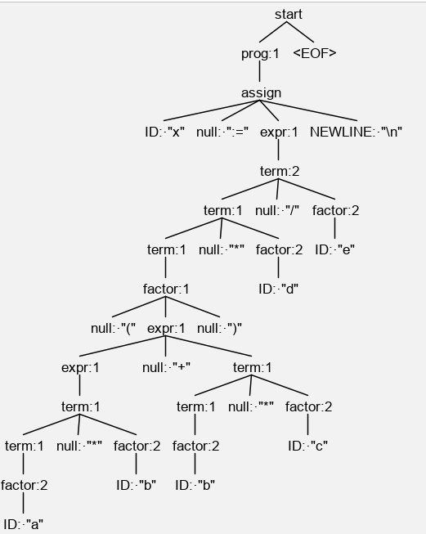
Test the grammar
Suppose the input string is:
x := (a*b + b*c) * d/e

Slide 129
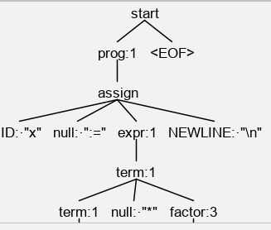
Test the grammar
For instance suppose the input string is:
x := (2 + 3) * 6
The parse tree will be:
Grammar:
start : prog EOF ;
prog : prog assign | assign;
assign : id ‘:=‘ expr (NEWLINE|EOF) ;
expr : expr ‘+’ term | expr ‘-’ term | term
Term : term ‘*’ factor | ‘ expr/factor | factor
factor : ‘(‘ expr ‘)’ | ID | Number

Slide 130
Step 4: Write the main function main.py
from antlr4 import *
from gen.assignment_statement_v3Lexer import assignment_statement_v3Lexer
from gen.assignment_statement_v3Parser import assignment_statement_v3Parser
from gen.assignment_statement_v3Listener import assignment_statement_v3Listener
import argparse
class MyListener(assignment_statement_v3Listener):
def exitFactor(self, ctx: assignment_statement_v3Parser.FactorContext):
pass

Slide 131
Step 4: Write the main function -1
def main(args):
# Step 1: Load input source into stream
stream = FileStream(args.file, encoding='utf8')
# input_stream = StdinStream()
# Step 2: Create an instance of AssignmentStLexer
lexer = assignment_statement_v3Lexer(stream)
# Step 3: Convert the input source into a list of tokens
token_stream = CommonTokenStream(lexer)
# Step 4: Create an instance of the AssignmentStParser
parser = assignment_statement_v3Parser(token_stream)

Slide 132
Step 4: Write the main function -2
# Step 5: Create parse tree
parse_tree = parser.start()
# Step 6: Create an instance of AssignmentStListener
my_listener = MyListener()
# Step 7: Create an instance of ParseTreeWalker
walker = ParseTreeWalker()
# Step 7: Walk through the parse tree in depth first order,
# while executing nonterminal enter/exit methods, listed in the listener file
walker.walk(t=parse_tree, listener=my_listener)
quit() # call quit() to go to the beginning of the input stream
lexer.reset()
token = lexer.nextToken()

Slide 133
Step 4: Write the main function -3
while token.type != Token.EOF:
print('Token text: ', token.text, 'Token line: ', token.line)
token = lexer.nextToken()
if __name__ == '__main__':
argparser = argparse.ArgumentParser()
argparser.add_argument(
'-n', '--file',
help='Input source', default=r'input.txt')
args = argparser.parse_args()
main(args)

Slide 134
Step 4: Run the program
Right click on the main.py file :
You will get the “unexpected indentation” error in the parser file : assignment_statement_v3Parser.py
The parser file includes all the actions added to the grammar.
Adjust the indentations and run the program.
Click on ANTLR preview key in tPyCharm
Select File option and enter the input file name, “input.txt”.
The content of the “input.txt” file will be displayed.
Click on the “parse tree” tab you will see the parse tree for the input file,

Slide 135
Step 4: Run the program - 1
For instance suppose the input string is:
x := (2 + 3) * 6
The parse tree will be:
Grammar:
start : prog EOF ;
prog : prog assign | assign;
assign : id ‘:=‘ expr (NEWLINE|EOF) ;
expr : expr ‘+’ term | expr ‘-’ term | term
Term : term ‘*’ factor | ‘ expr/factor | factor
factor : ‘(‘ expr ‘)’ | ID | Number

Slide 136
Step 4: Run the program -2
When you run the program with the input string :
x := (a*b + b*c) * d/e
the following three address code will br generated
by the program:
T1 = a * b
T2 = b * c
T3 = T1 + T2
T4 = T3 * d
T5 = T4 / e
Final Value: T5
Final type: str

Slide 137
Correcting indentations
The Gparser.py, generated by ANTLR for a grammar, g.g4, is untidy in the sense that indentations need to be fixed.
The Python code, listed in the next two slides, rearranges the indentations.

Slide 138
import os
import sys
if len(sys.argv) > 1:
filename = sys.argv[1]
else:
filename = input("Enter parser script's filename (Leave empty to automatically find in the current directory): ")
if filename == "":
current_dir_filemames = os.listdir(".")
for name in current_dir_filemames:
if name.endswith("Parser.py"):
filename = name
break
if filename == "":
print("Couldn't find any parser in this directory.\nAborting.")
exit()
else:
print("Fixing " + filename + ".")

Slide 139
print("Reading...")
file = open(filename, "r")
lines = file.readlines()
file.close()
print("Processing...")
for i in range(len(lines)):
space_count = 0
while space_count < len(lines[i]) and lines[i][space_count] == ' ':
space_count += 1
if space_count > 10 and space_count % 4 == 2:
lines[i] = lines[i][10:]
print("Writing...")
file = open(filename, "w")
file.writelines(lines)
file.close()
print("Done.")

Slide 140

Homework #4

Slide 141

All the projects are due in two weeks

Slide 142
Exercise 1
Modify the Assignment Statement grammar to include the following rule and generate both the AST and three address code for the grammar:
st : assign | forSt | compoundSt
forSt :
for ID in range ‘(‘ IDENTIFIER ( ‘,’ IDENTIFIER ) ? ‘)’ ‘:’ NEWLINE st
compoundSt: ‘{‘ sts ‘}’
sts : st NEWLINE | st NEWLINE sts
Example: for I in range (a, b) :
a = a + 1
Run the program with an example and show the result.

Slide 143
Exercise 2
Modify the Assignment Statement grammar to include the following rule and generate three address code and AST for the grammar:
st : assign | forSt | compoundSt
forSt : ‘[‘ assign ‘:’
for ID in range ‘(‘ IDENTIFIER ( ‘,’ IDENTIFIER ) ? ‘)’ ‘]’
compoundSt: ‘{‘ sts ‘}’
sts : st NEWLINE | st NEWLINE sts
Example:
[ a = b * b – a : for b in range( 5 : 10 )]
Run the program with an example and show the result.

Slide 144
Exercise 3
Modify the Assignment Statement grammar to include the following rule and generate both the AST and three address code for the grammar:
st : assign | condSt | compoundSt
condSt : ID = ‘(‘ ID > ID ‘)’ ? St : st
compoundSt: ‘{‘ sts ‘}’
sts : st ; | st ; sts
Example: a = ( b > c ) ? a + b : a – c
Means if (b > c) a = a + b; else a = b-cl;
Run the program with an example and show the result

Slide 145

Code Refactoring

Slide 146
What is refactoring
Refactoring is:
restructuring (rearranging) code in a series of small, semantics-preserving transformations (i.e. the code keeps working) in order to make the code easier to maintain and modify
Refactoring is not just arbitrary restructuring
Code must still work
Small steps only so the semantics are preserved (i.e. not a major re-write)
Unit tests to prove the code still works
Code is : More loosely coupled, More cohesive modules, and More comprehensible

Slide 147
Why refactoring
Why fix a part of your system that isn't broken?
Refactoring:
improves software's design
makes it easier to understand
helps you find bugs
helps you program faster

Slide 148
When refactoring
Refactor when you add function
Refactor first
Add new functionality then (in a “green” mode)‏
Refactor when you fix a bug
Obviously the code wasn't good enough to see the bug in the first place
Refactor when doing code reviews
It might be clear to you, but not to others
Pair programming is code review

Slide 149
Field refactoring
s

Slide 150
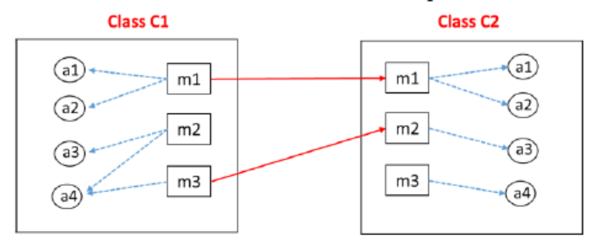
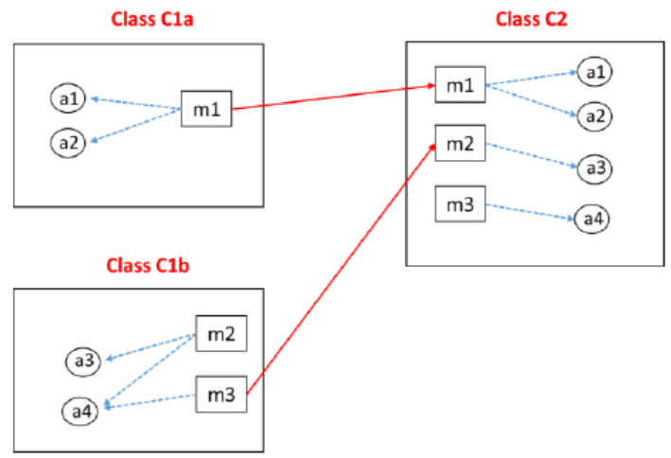
Extract Class refactoring
This refactoring allows you to extract members of an existing class to a new class.
For example, this refactoring can be helpful if you need to replace a single class that is responsible for multiple tasks with several classes each having a single responsibility.
Before refactoring
After refactoring

Slide 151
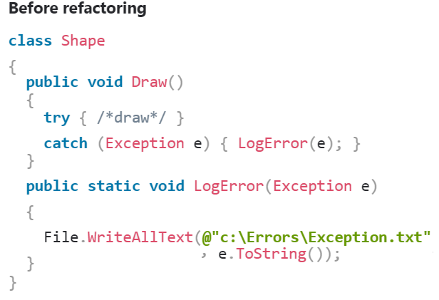
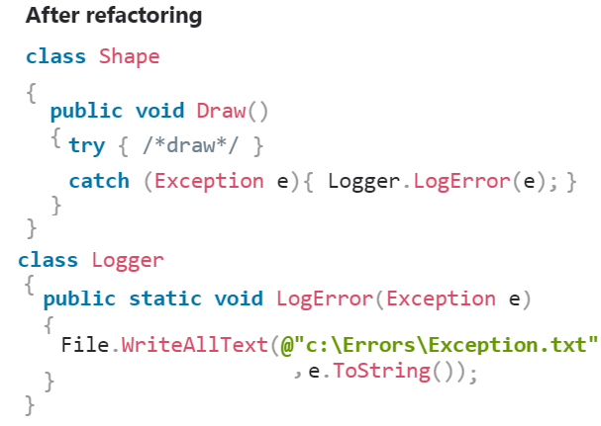
Extract Class refactoring

Slide 152
Data structures?
Python Collections (Arrays):
List is a collection which is ordered and changeable. Allows duplicate members.
Tuple is a collection which is ordered and unchangeable. Allows duplicate members.
Set is a collection which is unordered and unindexed. No duplicate members.
Dictionary is a collection which is unordered and changeable. No duplicate members.

Slide 153
Data structures?
For our project dictionary seems to be the most appropriate data structure.
Live demo.
Alist = ['Mon','Tue','Wed','Thu','Fri']
#Given list
print("Given list: ",Alist)
# Each element as list
NewList= [[x] for x in Alist]
# Print
print("The new lists of lists: ",NewList)
Output
Given list: ['Mon', 'Tue', 'Wed', 'Thu', 'Fri']
The new lists of lists: [['Mon'], ['Tue'], ['Wed'], ['Thu'], ['Fri']]

Slide 154

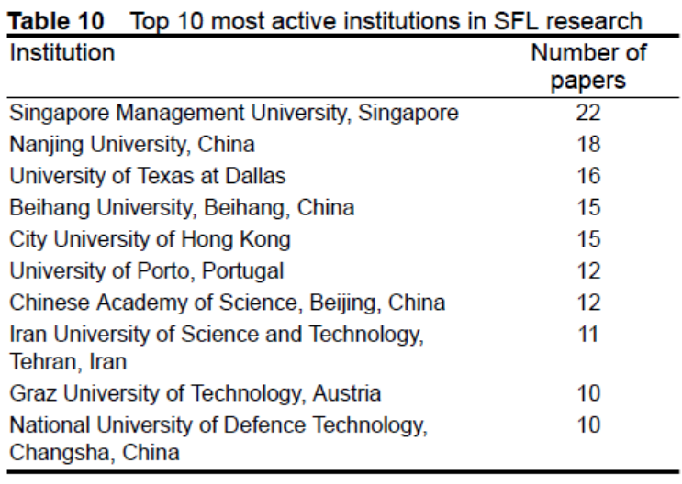
The place of IUST in the world
https://www.researchgate.net/publication/328099969_Software_Fault_Localisation_A_Systematic_Mapping_Study

Slide 155


